Slide 1




INVESTMENT OPPORTUNITY IN TANZANIA WITH RELATION TO ISLAMIC ECONOMY
5TH AFRICAN ISLAMIC FINANCE AND ECONOMIC SUMMIT 2018
HYATT REGENCY HOTEL –DARESSALAAM
SELEMAN ABDALLAH –AMC,CIPM, MPM.
PM CONSULTANT& FOUNDER SPM CONSULTING
LEAD AMBASSADOR AND FOUNDER HALAL PROJECTS AMBASSADORS

Slide 2
Introduction
Content ,Introduction & Background

Slide 3
Islamic Economy
Islamic (Religious Rules)
  Sharia –Quran and Sunnah
  Public/Community Law
Economy
  Business, Commerce and Trade
  Human Lifestyle

Slide 4
Islamic Institutions and Instruments:
Elimination of Riba; and Business Based
Contract Based
Halal Based

Slide 5
Islamic financial system;
  Banking and
  Microfinance
Zakah and Sadak;
Awqaf and Amana system
Takaful;

Slide 6
The main principle that has governed Islamic Economy is fiscal discipline, trust, efficiency in public expenditure, and avoidance of waste and haram (harmful)
This is the need and wants of every humanity

Slide 7
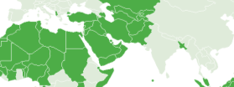
GLOBAL ISLAMIC ECONOMY OVERVIEW
ISLAMIC ECONOMIES – LARGE & FAST GROWING
The Islamic economies of the world represent more than $6.7 trillion in GDP
Some of the fastest-growing global economies that stretch from Indonesia in the east to Turkey in the west with the Arabian Gulf states at their centre.
Fast growing shari’a compliant investment, financing and trade
Islamic financial assets estimated at USD 1.66 trillion, and expected to double by 2019
1.7 billion Muslim population growing at twice the rate of the global population
Data by: DIEDC

Slide 8

GLOBAL ISLAMIC ECONOMY OVERVIEW
MUSLIM POPULATION – EXPANDING, YOUNG, ECONOMICALLY ACTIVE MARKET
Influence stretches beyond Muslim majority countries; more than 350 million Muslims live in non-Muslim majority nations
Fast growing and relatively young population of Muslims is increasingly asserting its Islamic sensitivities in the marketplace to products as varied as food, banking, and finance extending all the way to fashion, cosmetics, travel and healthcare.

Slide 9
Islamic Social Finance
Islamic Finance is the alternative to the interest bearing conventional micro-finance offered to Small and Medium Enterprises (SMEs) to raise debt or equity based fund.
It has been described as a powerful mechanism that offers financing to the entrepreneur low-income class of the society to enhance their financial inclusion (Obaidullah and Khan, 2008).
It uses various shariah compliant contracts such as Murabahah, qard-hassan, ijarah, salam and so on to broker debt based microfinance initiatives, while Mudarabah and Musharakah are generally employed in Islamic microfinance equity arrangement.

Slide 10
Islamic Social Enterprise
The engagement in business activities is regarded as obligatory (fard kifayah), and social development is considered an integral part of maintaining social values in Islam.
Islamic social enterprise is an entrepreneurial engagement which has social mission and comply with the rulings and principles of the Shari’ah which ensure a balance between material and spiritual outcomes.
Its derived from the Economy binded by the most important and aspect of life ie. Religious Belief – SHARIA COMPLIANT .

Slide 11
ISLAMIC SOCIAL FINANCE AND SOCIAL ENTERPRISE
ISLAMIC FINANCE
Food and Beverage Industry
Social Enterprise
Agri-business and Farming
ZAKAT &
WAQF
Education and Health
Pharmaceutical, Beauty and Fashion
MICROFINANCE SYSTEM
Tourism and Leisure

Slide 12
Its Found @ Four Factors of Production
Land: a gift of nature used in the production of goods and services through various means such as; purchase, exchange, and gifts.
Labour: is composed of all types of work engagement where an individual or group of people offer their expertise to an enterprise in return for wages or salaries.
Capital: it refers to physical assets such as money and machinery that are required to set up an enterprise.
Entrepreneur: is the one who coordinates the other factors of production.
The social enterprise leverages on this framework to perform their business functions.

Slide 13
Challenges
Inadequate Financing
Enormous task accessing financing from traditional financing institutions
Human Resource Personnel
limits the capacity of human resource

Slide 14
Opportunity
Investing in the ISE
Seed Fund Investment .
Capital Based Business

Slide 15
Opportunity Road-Map for Islamic Economy
Human Need
CAPITAL AND RESOURCES
FINANCIAL AND BANK, INSURANCE NEEDS
The Belief
QURAN AND SUNNAH
Human Benefits
SUPPLY , SERVICE AND
SERVING THE NEED
BOUNDED BY HALAL – HALAL ECONOMY
HALAL – SYMBOLICAL MEANS MORE THAN BEST

Slide 16
GLOBAL Islamic MARKET
The USD $ 3 Trillion Global Islamic Market is divided in the following sectors:
SECTOR | Market 2013 US $ (Billions)
Halal Food | $ 1,292
Islamic Finance | $ 1,214
Islamic Fashion | $ 266
Halal Tourism | $ 140
Media & Recreation | $ 185
Halal Pharmaceuticals | $ 72
Halal Cosmetics | $ 46
Potential Market 2019, US $ (Billions)
$ 2,536
$ 4,178
$ 484
$ 238
$ 301
$ 103
$ 73
Source: State of the Global Islamic Economy 2015-2016/

Slide 17
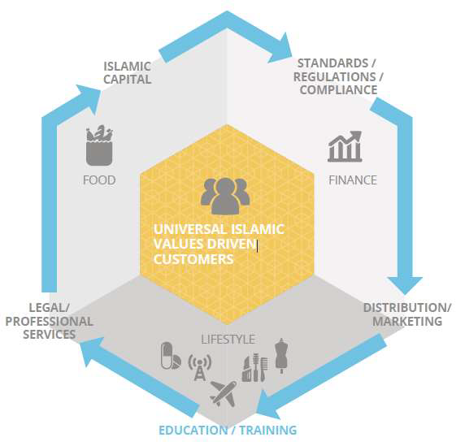

Slide 18
The Islamic economy is booming largely having avoided the recession as many other Economy have suffered from.

Slide 19
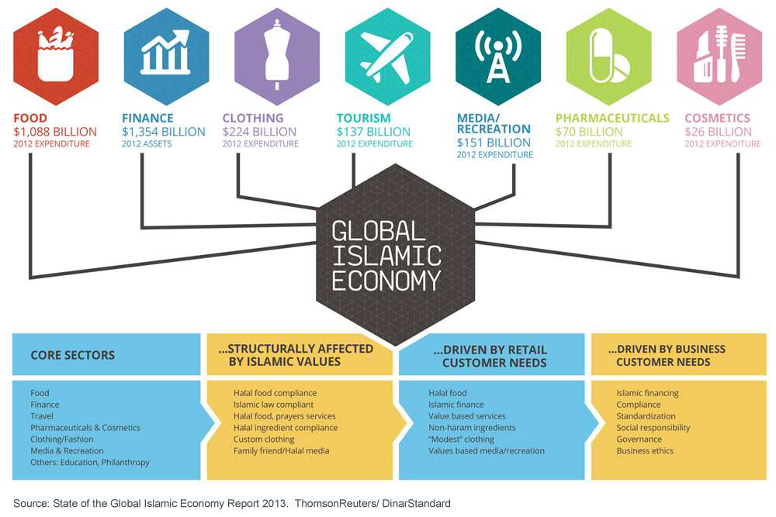
Global Halal Lifestyle markets: reach $2.47 trillion by 2018 expected to reach $2.47 trillion by 2018

Slide 20
Lets Come to Tanzania
Tanzania we are not at the Best Position Compared to other part of the world
National Population of 55.57 Million (2016-World Bank)
Approximately More than 45% Muslim Population –
More than 88% they Demand –Islamic Economy Support – Islamic Finance

Slide 21
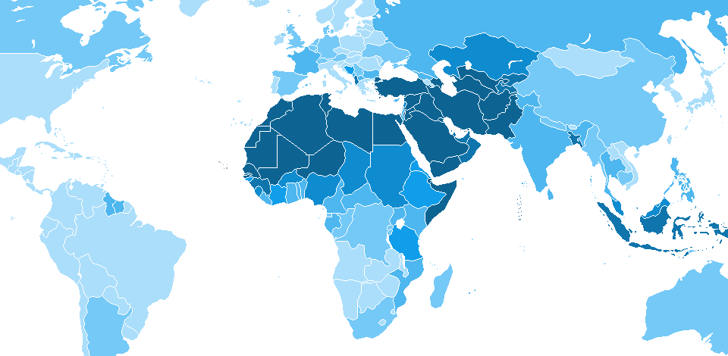
We are Among 57 mostly Muslim majority countries
 Attractive young demographic
 Growing economies

Slide 22
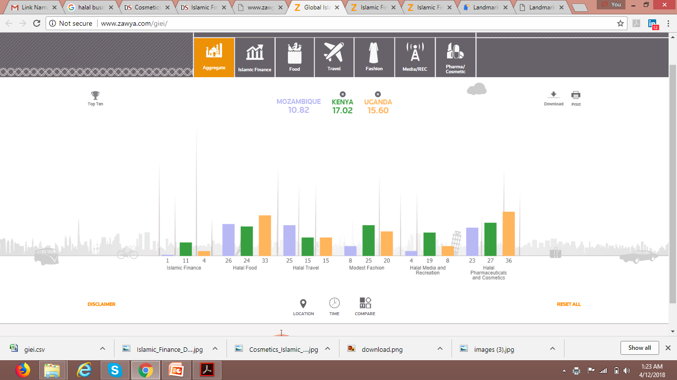
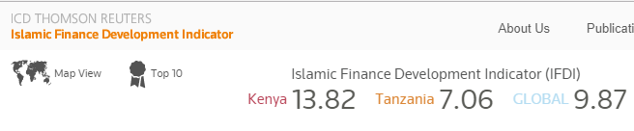
GLOBAL ISLAMIC ECONOMY INDICATOR (GIEI) – COMPARISON
Year: 2017
Level 1 |  | Level 2
Country | GIEI | Country | Islamic Finance | Halal Food | Halal Travel | Modest Fashion | Halal Media and Recreation | Halal Pharmaceuticals and Cosmetics
Global | 22.43 | Global | 17.97 | 28.31 | 20.34 | 17.17 | 21.65 | 26.01
Kenya | 17.02 | Kenya | 10.56 | 23.61 | 14.79 | 25.05 | 19.38 | 26.55
IN EAST AFRICA KENYA IS LEADING FOLLOWED BY UGANDA
http://www.zawya.com/giei/

Slide 23
WHY INVEST IN
TANZANIA?
Peace & Political Stability
>> Strategic Location
>> Attractive Investment Regime
>> Investment Incentives
>> Investment Guarantees
>> Plenty of Natural Resources
>> High Growth Potential
>> Memberships of Bilateral Trade Agreements
>> Public Private Partnerships
>> Export Processing and Special Economic Zones
>> Magnificent Business and Leisure Destinations

Slide 24
PRIORITY AREAS OF INVESTMENT
AGRICULTURAL & LIVESTOCK
Agriculture Sector, with annual growth rate of 6%, accounts for nearly half of national GDP contribution, 70% of rural household income, and absorbs 80% of the entire workforce.
Current Situation:
Tanzania Livestock Population increasing by 5% per annum; its 21.3 million large cattle population make it the biggest in Southern Africa
Market Opportunity: Growing Urban Population of 4.7% in East Africa
PROPOSAL :
SALAAM MODEL; MUSHARAKAH & MURABAHA
HORTCULTURE
RICE SUGAR CANE
POTATOES
POULTRY
DIARY AND MEAT
FISHING (MODERN FISHING)
AGRICULTURE NEEDS FINANCIAL CAPITAL
MORE THAN 50% ARE MUSLIM WHO ESCAPE INTEREST LOANS, MORE THAN 11% ARE NON MUSLIM WHO DISLIKE INTEREST LOAN MODEL

Slide 25

2. NATURAL RESOURCES
Natural Resources in Tanzania refer to forestry & Beekeeping, Wildlife and Fisheries
Country has vast untapped natural resources that provide a base for investment in factories, industries and training.
Fisheries: Tanzania rank top among the 10 potential in Africa and Leading in East and Central Africa ; Almost 6.1% of the Country area is the Fishing water body. Around 3M Tones of the Fishing Potentials
Forestry
Forest and Woodland in Tanzania are estimated to cover about 35.5 million hectares, and constitute about 38% of the total area of the country.
Beekeeping
Tanzania has a large potential for the establishment and management of bee reserves. Beekeeping plays a major role in socio – economic development and environmental conservation. Potential of ---138,000 Tons of Honey and 9,200 of Bee wax

Slide 26
3.TOURISM
More than 44% of the Tanzania Land is covered by Tourism areas and Tour site.
There are 16 national parks, 29 Game reserve and 40 controlled conservation areas and marine parks.
Tanzania is also home to the famous ‘Roof of Africa’, Mount Kilimanjaro. On 6 January 2012, The New York Times newspaper awarded Tanzania the 7th position among 45 areas to visit in the world .
HALAL FRIENDLY TOURISM
Hotels, Restaurants, Resorts, Camps and Lodges
SHARIA COMPLIANTS TOURISM
Tours and Hotel Operators, Halal Friendly Trips and Travels
SME SECTOR AND LINK TO SHARIA COMPLANTS FINANCIAL INSTITUTIONS

Slide 27
4.MANUFACTURING & CONSTRUCTION
The Government Policy
The Investment Privilege
Manpower and Natural Resources
Business through SME-Industries
  Capital Financing
  Lease Financing
  Musharaka Models

Slide 28
OTHER AREAS
5. OIL AND GAS EXPLORATION AND PRODUCTION
6. MINING
7. Transportation and Logistics
8. Real Estate and Housing
9. ICT and Service Consultancy
10.FINANCIAL INSTITUTION –It Links Above
This sector presents plenty of investment opportunities, such as:
Refinery Activities, Value Added Activities , Processing and Extraction at the Small and Medium Scale

Slide 29
TANZANIA’S STRATEGIC ISLAMIC ECONOMY VISION
THE FASTEST GROWING SECTORS
Financial Services
Tourism
Oil & Gas
Telecommunication
Transport & Logistics
Trade
TANZANIA’S POSITION AMONG THE FASTEST GROWING INDUSTRIES IN THE WORLD
Electricity
&
Water
Manufacturing
Construction
Professional Services
Agriculture
Government Services
THE SLOWEST GROWING SECTORS
WEAK
STRONG
TANZANIA’S STRENGTH ACCORDING TO INTERNATIONAL STANDARDS

Slide 30
CRUTIAL AREAS
ISLAMIC FRIENDLY APPROACH AND MODELS TO TRAP ALMOST MORE THAN 65% OF THE POPULATION DESIRE
HEALTH -
EDUCATION
ENTERTAINMENT
FASHION INDUSTRY
INSURANCE
SECURITY AND SAFETY

Slide 31
Opportunities and Gap
Islamic Finance – Microfinance
Islamic Insurance
Food & Beverage
Travel and Tourism
Fashion and Wear/Clothers
Cosmetics/ Personal care/Fitness
Pharmaceutical and Medical Service
Media/ Recreation & Entertainment

Slide 32
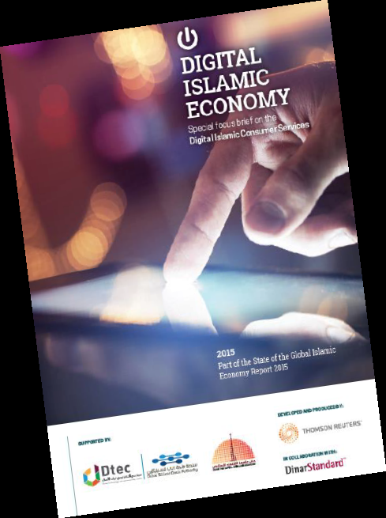
DIGITAL ISLAMIC ENTREPRISE
Report defines “Digital Islamic Services” as those digital-native, consumer-facing services whose primary offering is driven by “ISLAMIC CONTENT AND REQUIREMENT”
Muslim consumer value to the global digital economy estimated at $107B in 2014 and projected to grow at 17% CAGR to $277B in 2020.
Two key drivers:
1.General lifestyle needs: 4 categories of global digital services: Information& media (Google, iTunes), Functional tools & services (Skype, PayPal), Commerce & exchange (Ebay, AirBnB) and Social & crowd networks (Facebook).
2.Islamic law/ spirituality lifestyle needs: Religious lifestyle productivity, Halal food ratings and review, Modest clothing, among others

Slide 33
Global Digital Services most all serve “General Lifestyle Needs” of Muslim consumers
Example
Digital Halal Tourism sites
Digital Halal Accomodation sites
Digital Halal Food Service etc. sites
Muslim Friendly Ringtones etc
Muslim Matters Informers & Online Media
Islamic Online Education (swahili) & Explorer
Crowfunding

Slide 34
Halal Projects Ambassadors (HPA)
HPA is founded on the seven pillars of finance, the ‘halal’ industry, tourism, digital infrastructure, art, knowledge and Islamic standards.
Through carefully planned strategies and initiatives, HPA is committed to engaging with stakeholders to foster a generation of qualified professionals with the required skill-sets to drive growth across the seven constituent pillars, while creating a dynamic and competitive environment that fuels growth within the sector.

Slide 35
Objectives Cont….
Work with public and private sector partners, within and outside the EAC, to drive growth across seven Islamic economy sectors.
Implement a comprehensive strategy of practical initiatives and programmes designed to position Tanzania as the EAC-Hub of the Islamic economy.

Slide 36
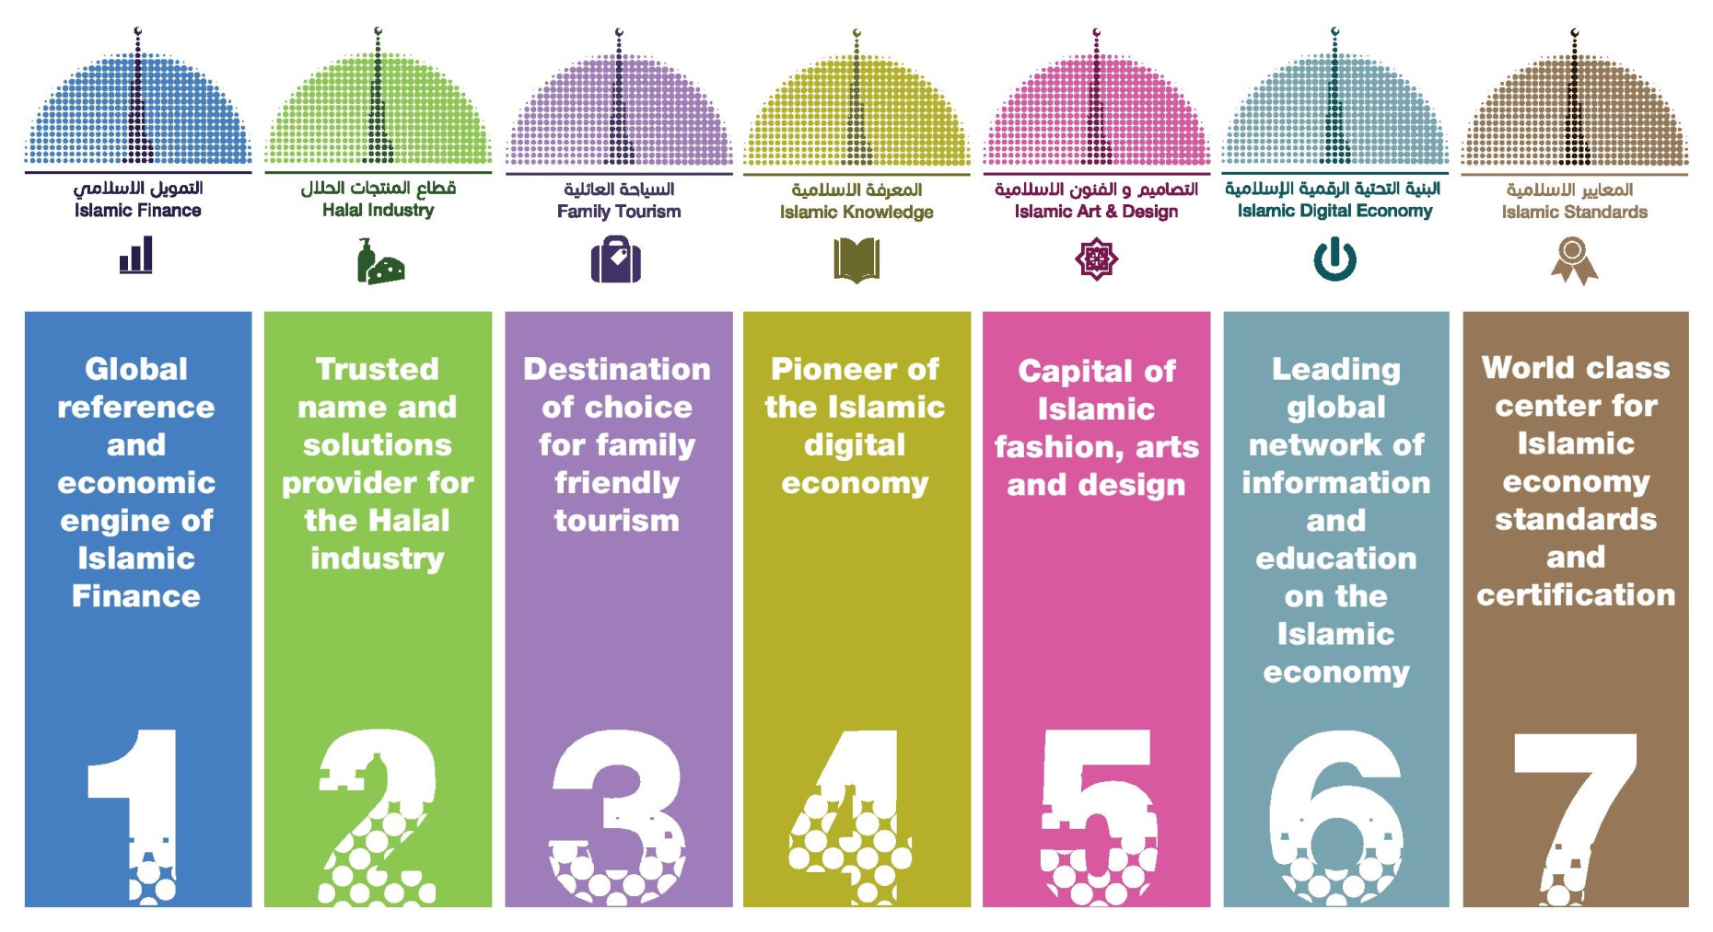
STRATEGIC PILLARS
HPA seeks to develop an enabling and empowering environment, including the necessary legislative and regulatory framework, to support the growth of the Islamic Economy. This is done through 7 key strategic pillars:
Regional Reference and Economic Engine of Islamic Finance and Microfinance
Trusted Name and Network for the Halal Industry and Service
Destination of Choice in EAC Halal Tourism and Travel Point
Regional Pioneer of the Islamic Digital Economy
Regional Reference and Centre for Islamic Fashion, Arts and Design
Regional Network of Information and Education on the Islamic Economy
Regional Reference and Economic Centre of Islamic Standards and Recognition

Slide 37
Remark
Islamic social mechanism - an effective tool to ameliorate poverty and provide the poor with the opportunity to live in dignity.
There is a need for collaboration with government and other private entities to provide safety net to the entrepreneurs in the society in line with the principle of Shari’ah. (Good Support from TIRA & BOT)
A very essential approach to address these challenges is to institutionalize the third sector.
Islamic social enterprise can tap into the potential of Islamic social finance and ensure the sustainability of social entrepreneur.

Slide 38
To Sum Up
ISLAMIC SOCIAL FINANCE
is borderless. Let us break the barriers to build strong Islamic Social Enterprise
The Need of
  International Islamic Microfinance Support
  Waqf and Zakat to suppot as well as
  Micro-takaful
We need Consultancy and Investors on Above

Slide 39
Thanks for your Time
SELEMAN ABDALLAH –PMO & ME Consultant
www.spmconsultingtz.com
Founder of Halal Projects Ambassadors (EA)
www.halalprojects.com
+255712008227
seleman@spmconsultingtz.com
halalprojectstz@gmail.com

